Slide 1
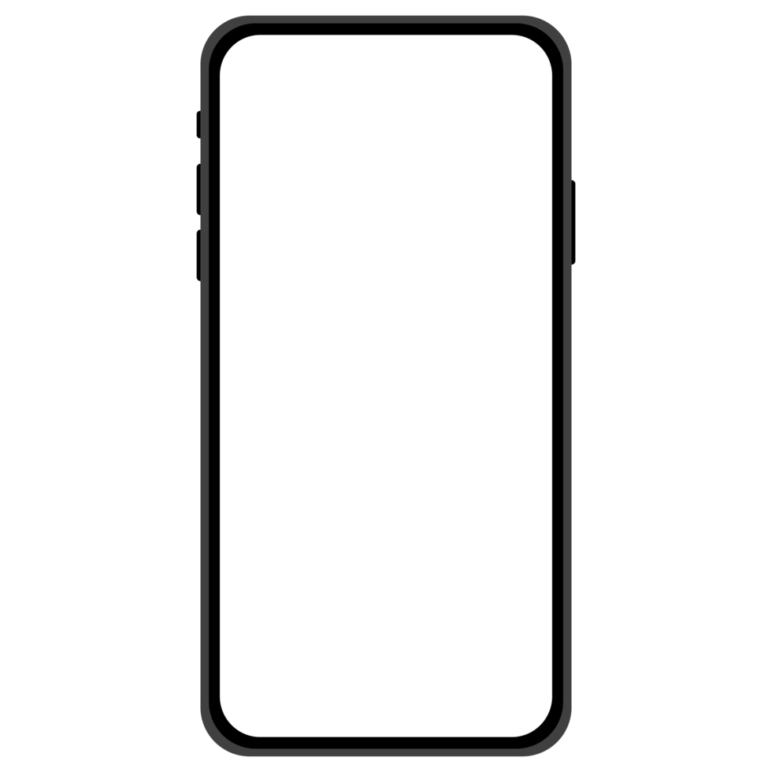




Food
A Mobile Application Development Project
Group 9
Our team
Nguyen Hai Long BA9-037
Van Quoc An BI11-004
Pham Minh Hieu BI11-090
Hoang Quang Huy BI11-111
Le Dinh Thong BI11-257
UFood
Delivery

Slide 2
Food
Agenda
A Mobile Application Development Project
Group 9
Our members
Nguyen Hai Long BA9-037
Van Quoc An BI11-004
Pham Minh Hieu BI11-090
Hoang Quang Huy BI11-111
Le Dinh Thong BI11-257
Introduction
Design Mechanism
Demo
Delivery

Slide 3





Design Mechanism
Introduction
Agenda
I’m hungry
received order
Let’s order food from Ufood
cooking
Demo
UFood
transfer
Now we need an interface
choose food
payment
order
deliver
dev member

Slide 4
Design Mechanism
Introduction
Tool using:
Java 1.9
Desugaring API
Android Gradle Version 7.3
Gradle Version 7.4
Minimum requirements:
Android Lolipop (
Recommended requirements:
Android Pie (9.0)
References:
Official Android Documents
choose food
payment
order
UFood
Now we need an interface
dev member

Slide 5
Design Mechanism
Introduction
<RelativeLayout
...
<View
.../>
<LinearLayout
...
<ImageView
.../>
<TextView
.../>
</LinearLayout>
...
</RelativeLayout>
choose food
payment
order
Splash Screen
Now we need an interface
dev member

Slide 6
Design Mechanism
<RelativeLayout
...
<View
.../>
...
<LinearLayout
...
<TextView
.../>
<TextInputLayout
.../>
<TextInputLayout
.../>
<Button
.../>
</LinearLayout>
</RelativeLayout>
Login Screen

Slide 7
Design Mechanism
<<include
android:id="@+id/toolbar”
layout="@layout/toolbar"
.../>
// Or now we said...
<Toolbar/>
<LinearLayout
<ImageView/>
<RatingBar/>
<TextView/>
<TextView/>
</LinearLayout>
<androidx.recyclerView
.../>
<FloatingActionButton
...
/>
Main Screen

Slide 8
Design Mechanism
<Toolbar/>
<RatingBar/>
<SquareImageView/>
<Button/>
<TextView/>
<ImageView/>
Details Screen – p1

Slide 9
Design Mechanism
<RecyclerView/>
<TextView/>
<ImageView/>
<ItemCommand/>
Details Screen – p2

Slide 10
Design Mechanism
<Button/>
<Toolbar/>
<RecyclerView/>
Cart Checkout

Slide 11
Thank you for listening to us!
Next: Our demo

